Slide 1


Titolo presentazione sottotitolo
Amazon Forest Monitoring using the U-Net Fully Convolutional Neural Network
Milano, XX mese 20XX
Master of Science in Geoinformatics Engineering
Angelly de Jesus Pugliese Viloria - 10700460
Supervisor: Professor Maria Brovelli, Ph.D.
Co-supervisor: Eng. Vasil Yordanov

Slide 2
Contents
Introduction and case of study
Tools and technologies
Methodology
Parameter tuning
Results and discussion
Conclusion

Slide 3
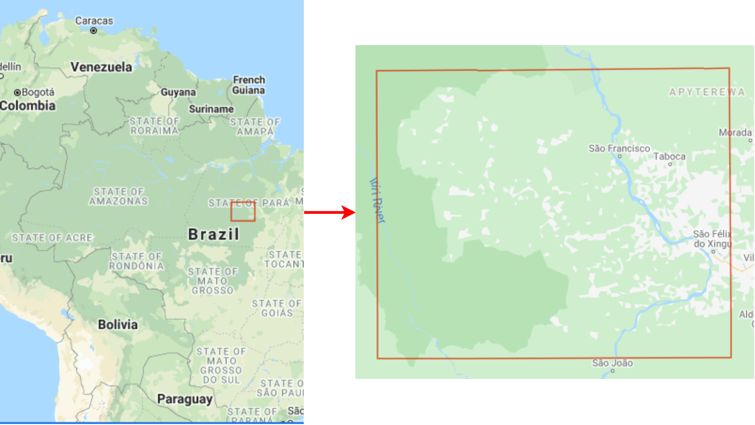
Introduction and case of study
Land cover classification.
Area of interest (AOI) in the state of Pará, first in forest loss with 14.8Mha between 2001 to 2020.
AOI has ≅ 49118 km².
20-year monitoring period, every 5 years.
AOI in the state of Pará, Brazil

Slide 4
Satellite imagery
Composite images from May to August, using the RGB and NIR bands.
Landsat 5 (continuity)
30 meter spatial resolution
Landsat 8 (continuity)
30 meter spatial resolution
Sentinel 2 (spatial resolution)
10 meter spatial resolution

Slide 5
Tools and technologies
Tools and technologies
Google Earth Engine, raw and classified data source.
Google Colaboratory, IDE to run the scripts written in Python.
TensorFlow and Keras, used to define the U-Net model, train, and predict.
Google Cloud Storage and Google Drive, to store the assets and models.
QGIS, to validate the classifications.
AcaTaMa plugin, to generate the training dataset.

Slide 6
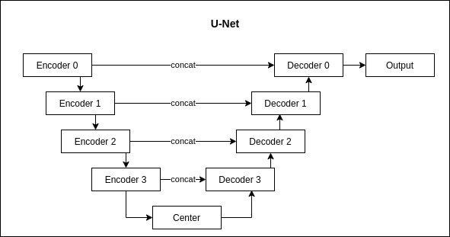
Methodology - U-Net Fully Convolutional Neural Network

Slide 7
Methodology - U-Net Fully Convolutional Neural Network
Loss functions and optimizer
Cross-entropy loss function: outputs a logarithmic score proportional to the difference between the true and expected values.
Dice or Sørensen loss function: computes the similarity between the predictions performed by the model and the true values of the testing samples.
Adaptive Moment Estimation (Adam) optimizer: computes individual adaptive learning rates for different parameters from estimates of first and second moments of the gradients.

Slide 8
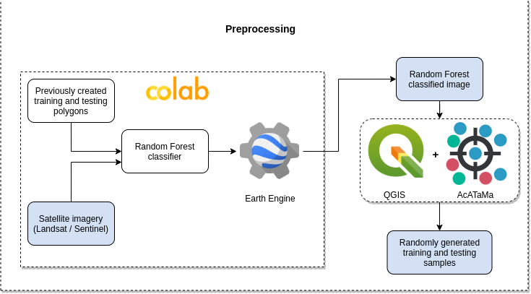
Methodology - preprocessing

Slide 9
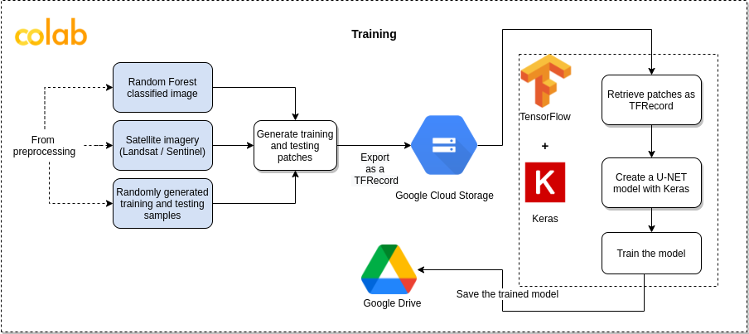
Methodology - training

Slide 10
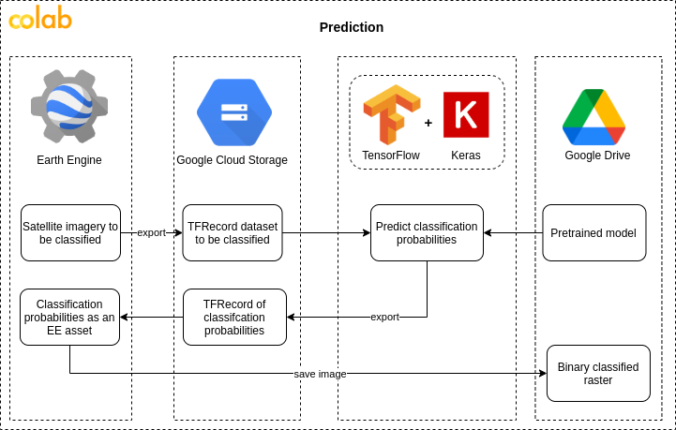
Methodology - prediction

Slide 11
Methodology - validation
User’s accuracy
Producer’s accuracy
Overall accuracy
Kappa index

Slide 12
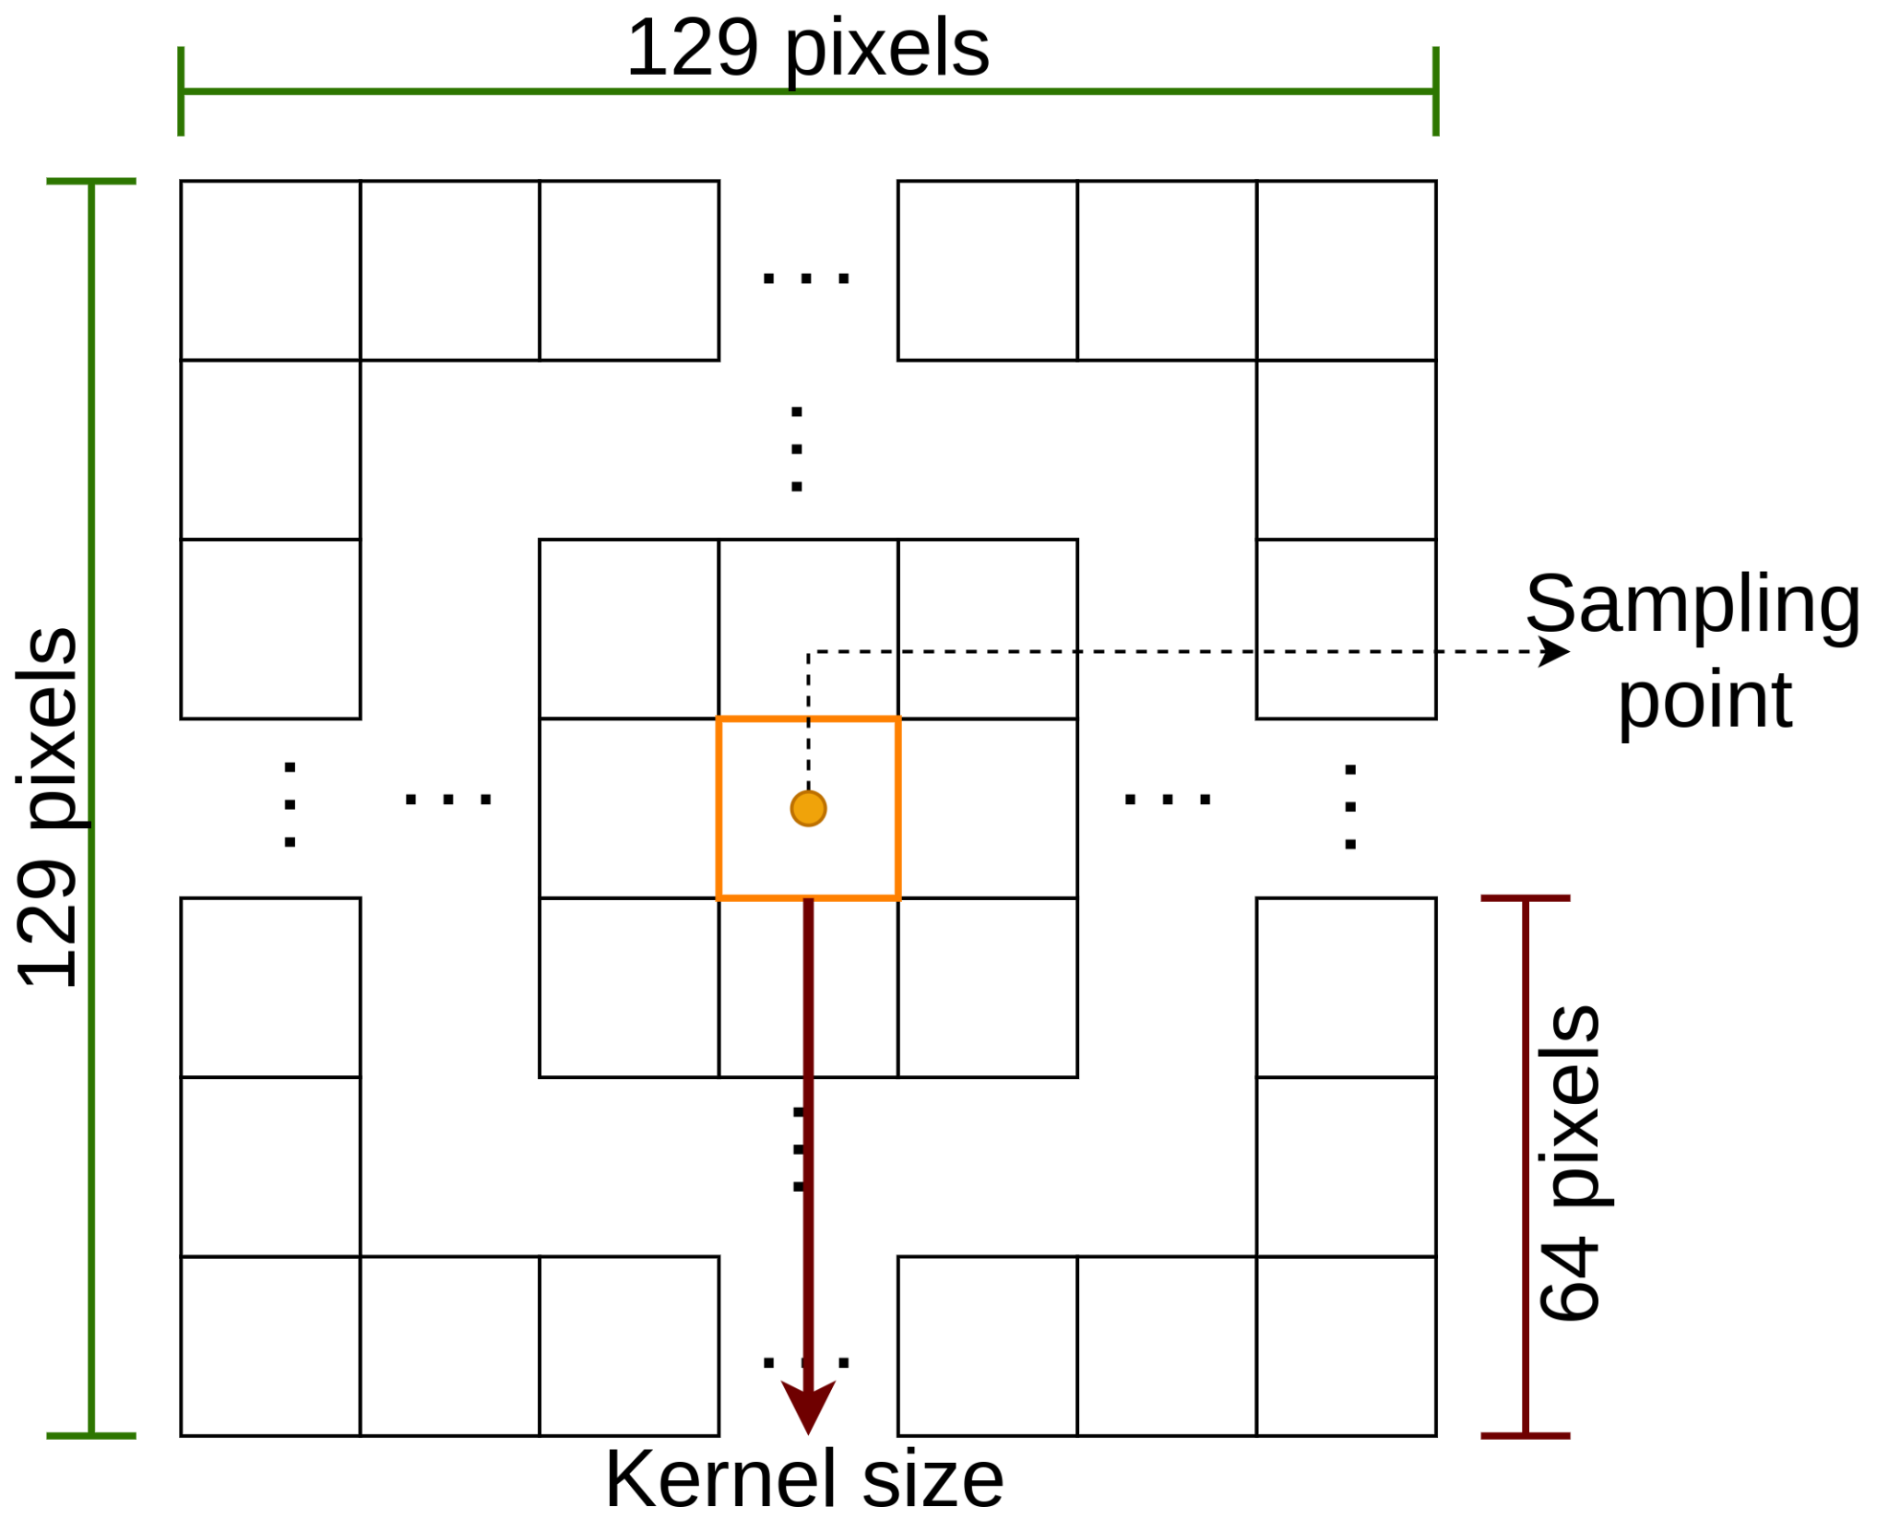
Parameter tuning
Kernel size -> patch size
Size of the training and testing dataset
Diversity of the training patches
kernel size and sampling point neighborhood

Slide 13
Parameter tuning - kernel and dataset size
Kernel size | Training data size | Testing data size
64 | 1000 | 300
 | 500 | 150
 | 100 | 30
 | 50 | 15
32 | 1000 | 300
 | 500 | 150
 | 100 | 30
 | 50 | 15
16 | 1000 | 300
 | 500 | 150
 | 100 | 30
 | 50 | 15

Slide 14
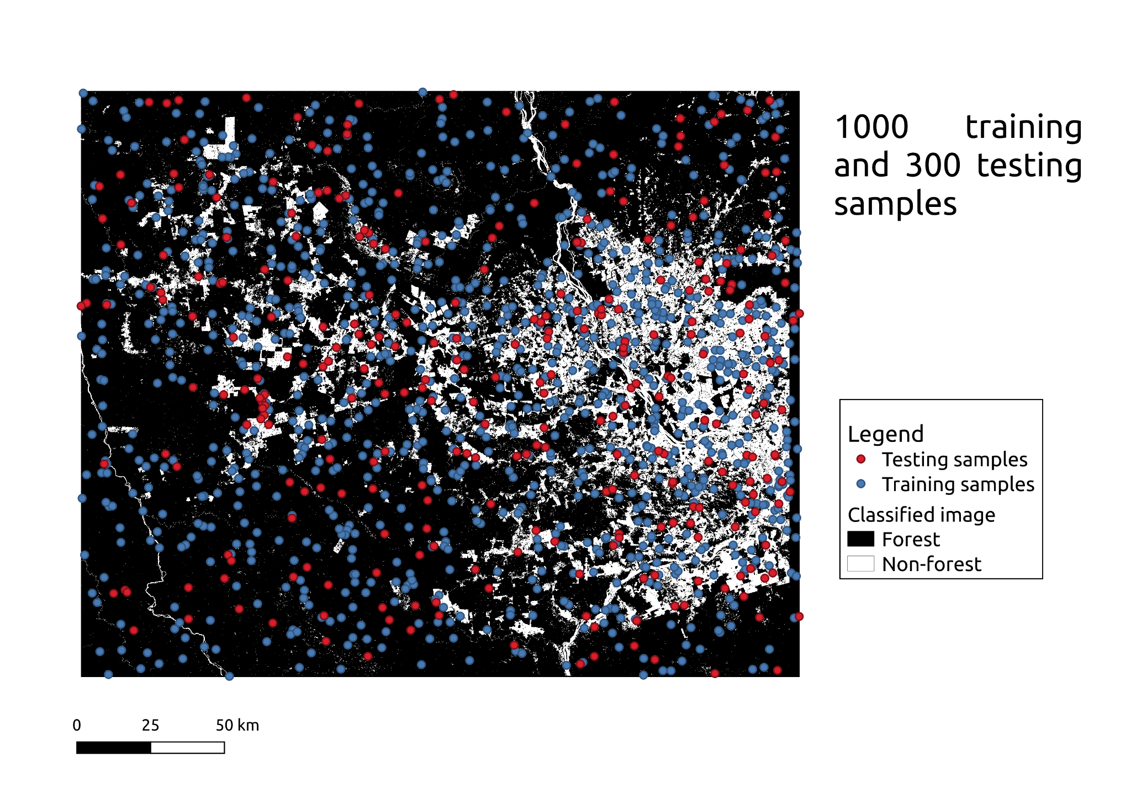
Parameter tuning - kernel and dataset size

Slide 15
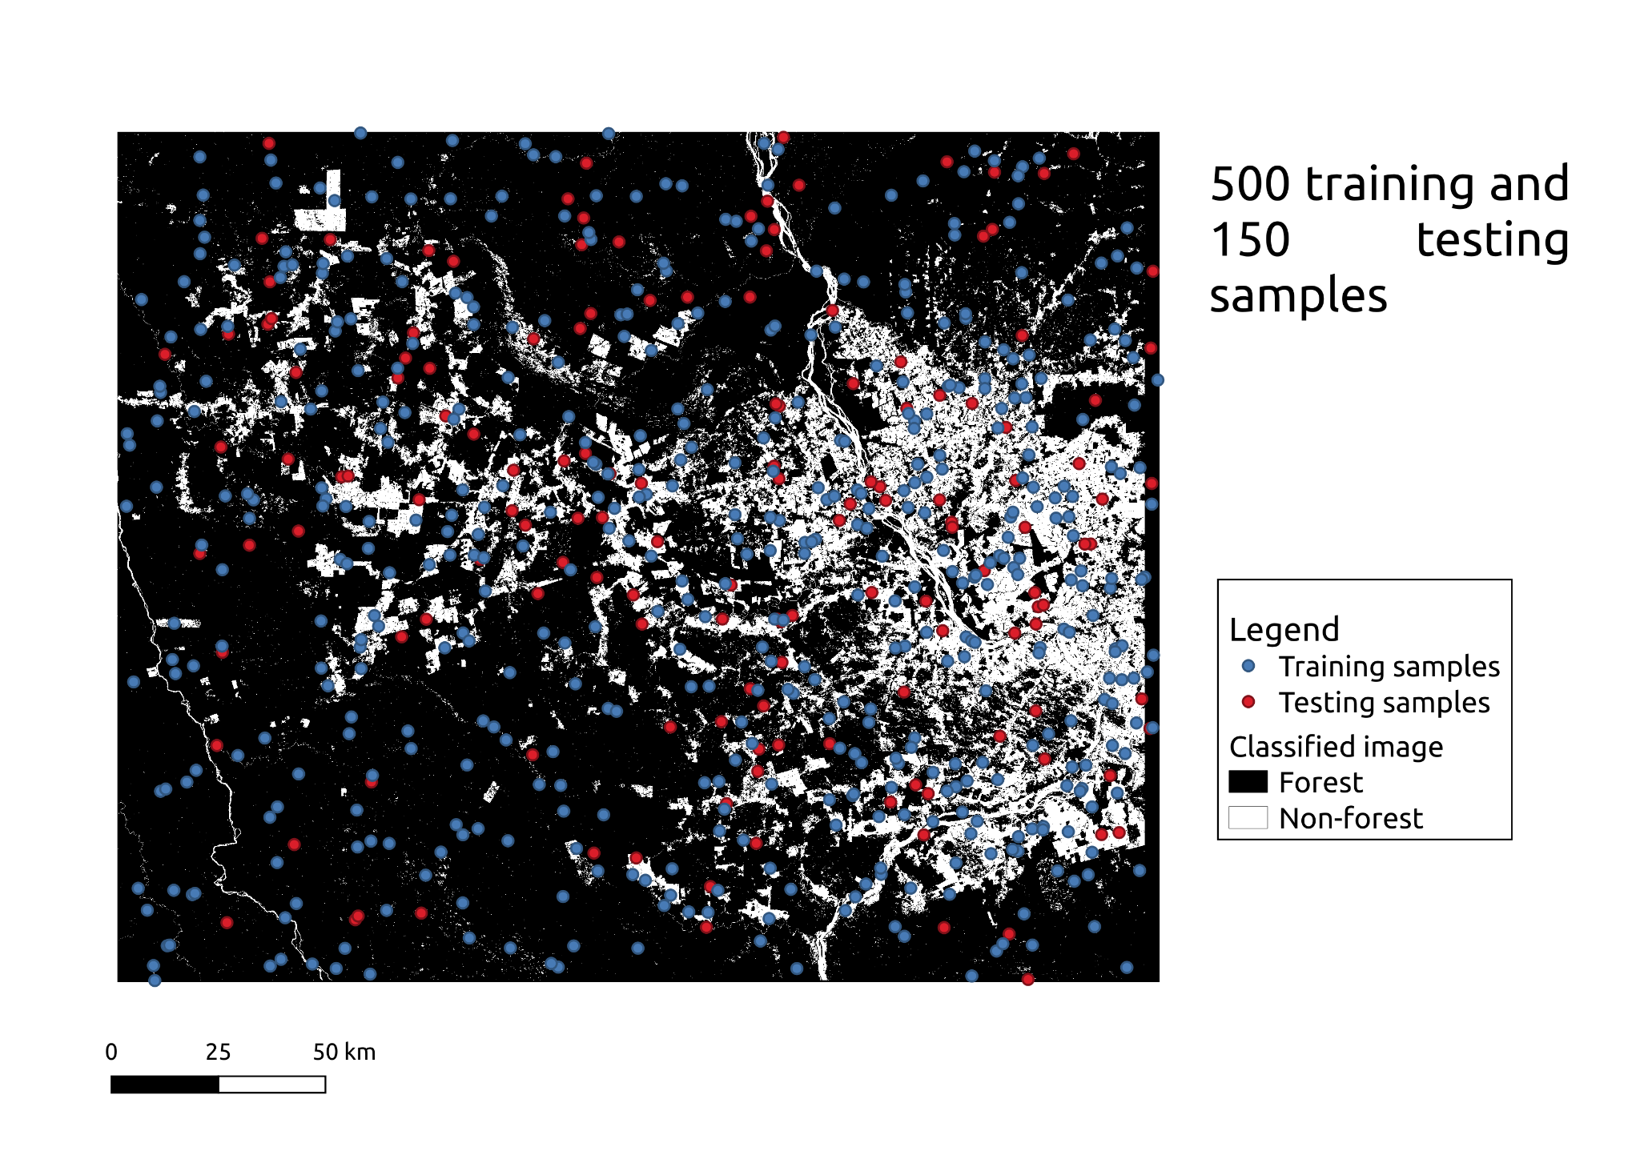
Parameter tuning - kernel and dataset size

Slide 16
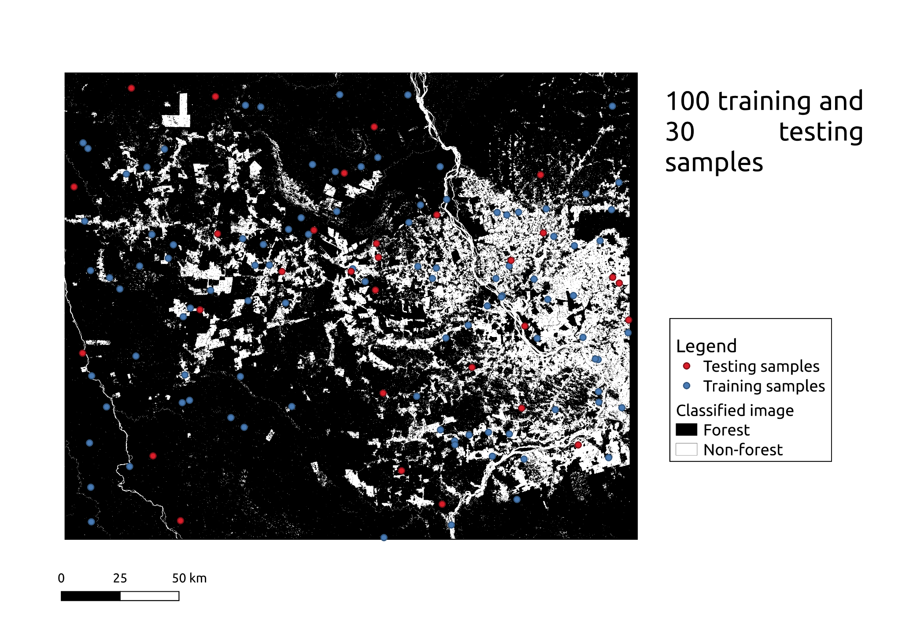
Parameter tuning - kernel and dataset size

Slide 17
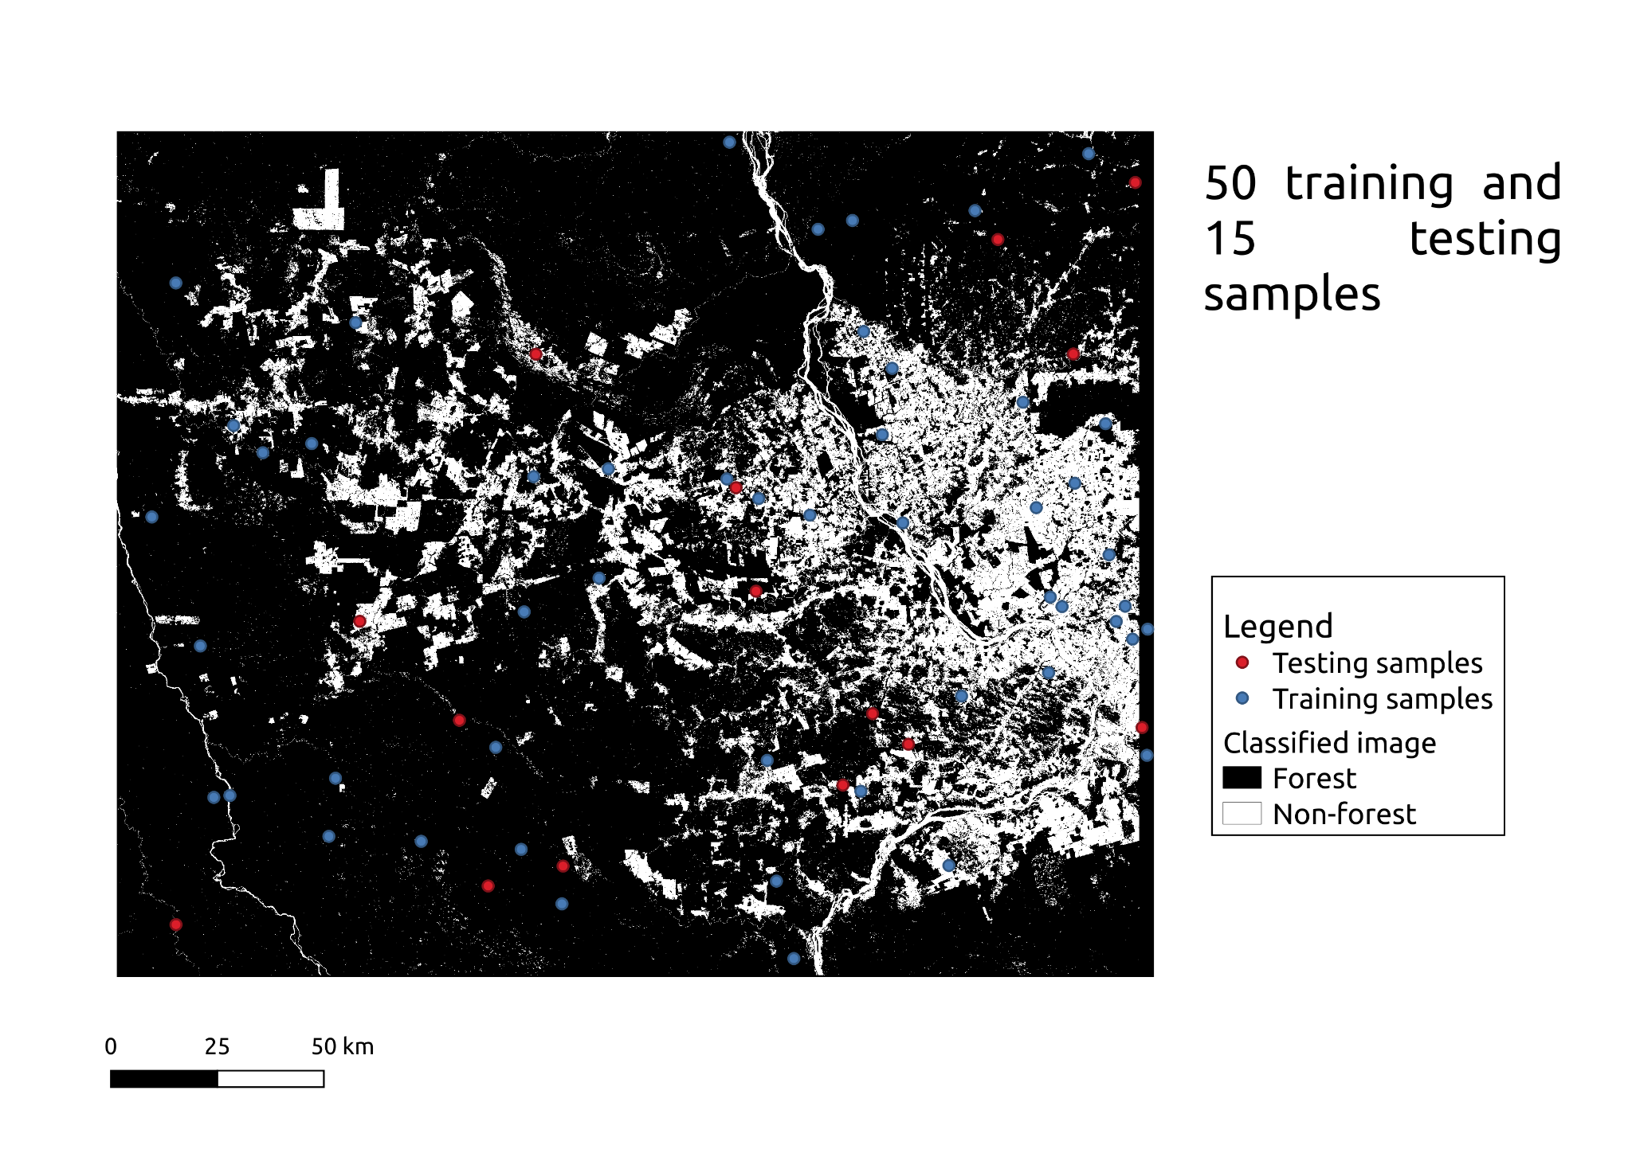
Parameter tuning - kernel and dataset size

Slide 18
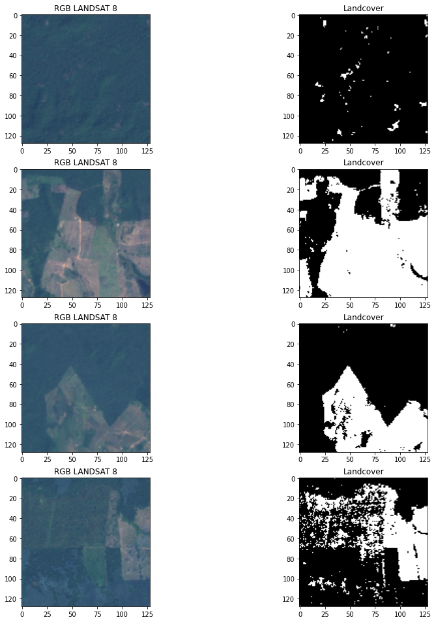
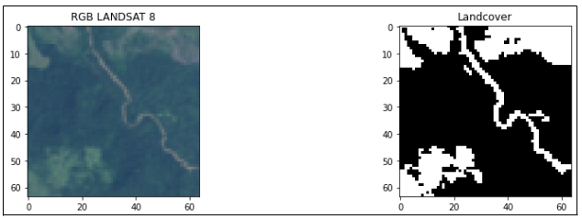
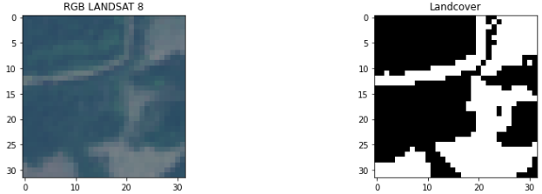
Parameter tuning - kernel and dataset size
Kernel 64
Kernel 32
Kernel 16

Slide 19
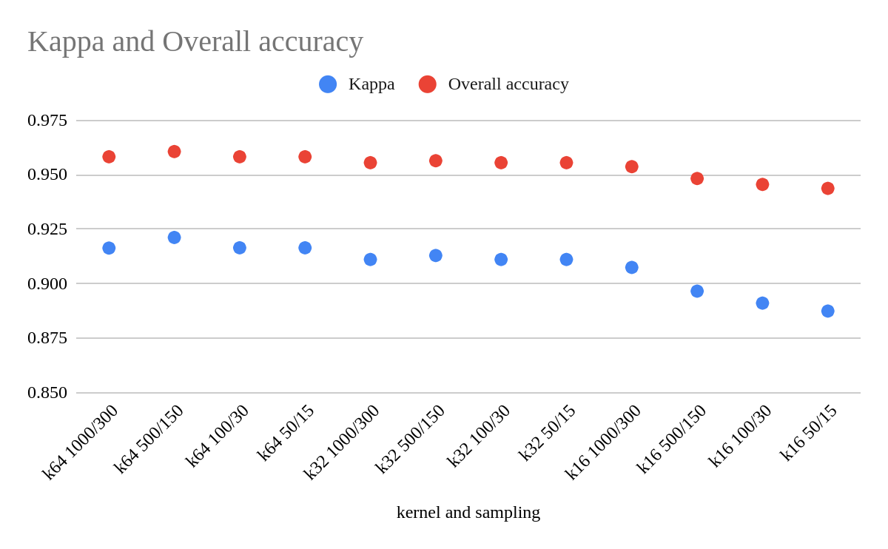
Parameter tuning - kernel and dataset size

Slide 20
Parameter tuning - diversity of the training patches
Three different datasets were considered:
Non-diverse dataset
Dataset with high diversity
Dataset with symmetrically distributed diversity
How is diversity computed?
Shannon index, to measure diversity regardless of the spatial distribution.
Joint counts, to measure the quantity of forest-forest (BB), non-forest-non-forest (WW), and forest-non-forest (BW/WB).
Dispersion index, computed from joint counts BW/(WW+BB+BW)

Slide 21
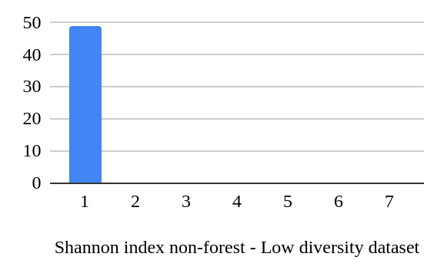
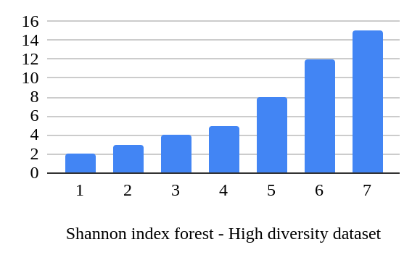
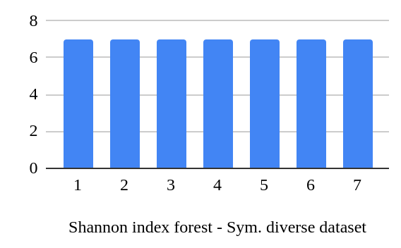
Parameter tuning - diversity of the training patches

Slide 22
Parameter tuning - diversity of the training patches
Dataset comparison | Landsat 8 2019 |  | Landsat 8 2015
 | Overall accuracy | Kappa Index | Overall accuracy | Kappa Index
Dataset with low diversity | 0.7849 | 0.5686 | 0.7877 | 0.5754
Dataset with high diversity | 0.9474 | 0.8946 | 0.9651 | 0.9302
Symmetrically diverse dataset | 0.9474 | 0.8946 | 0.9587 | 0.9174

Slide 23
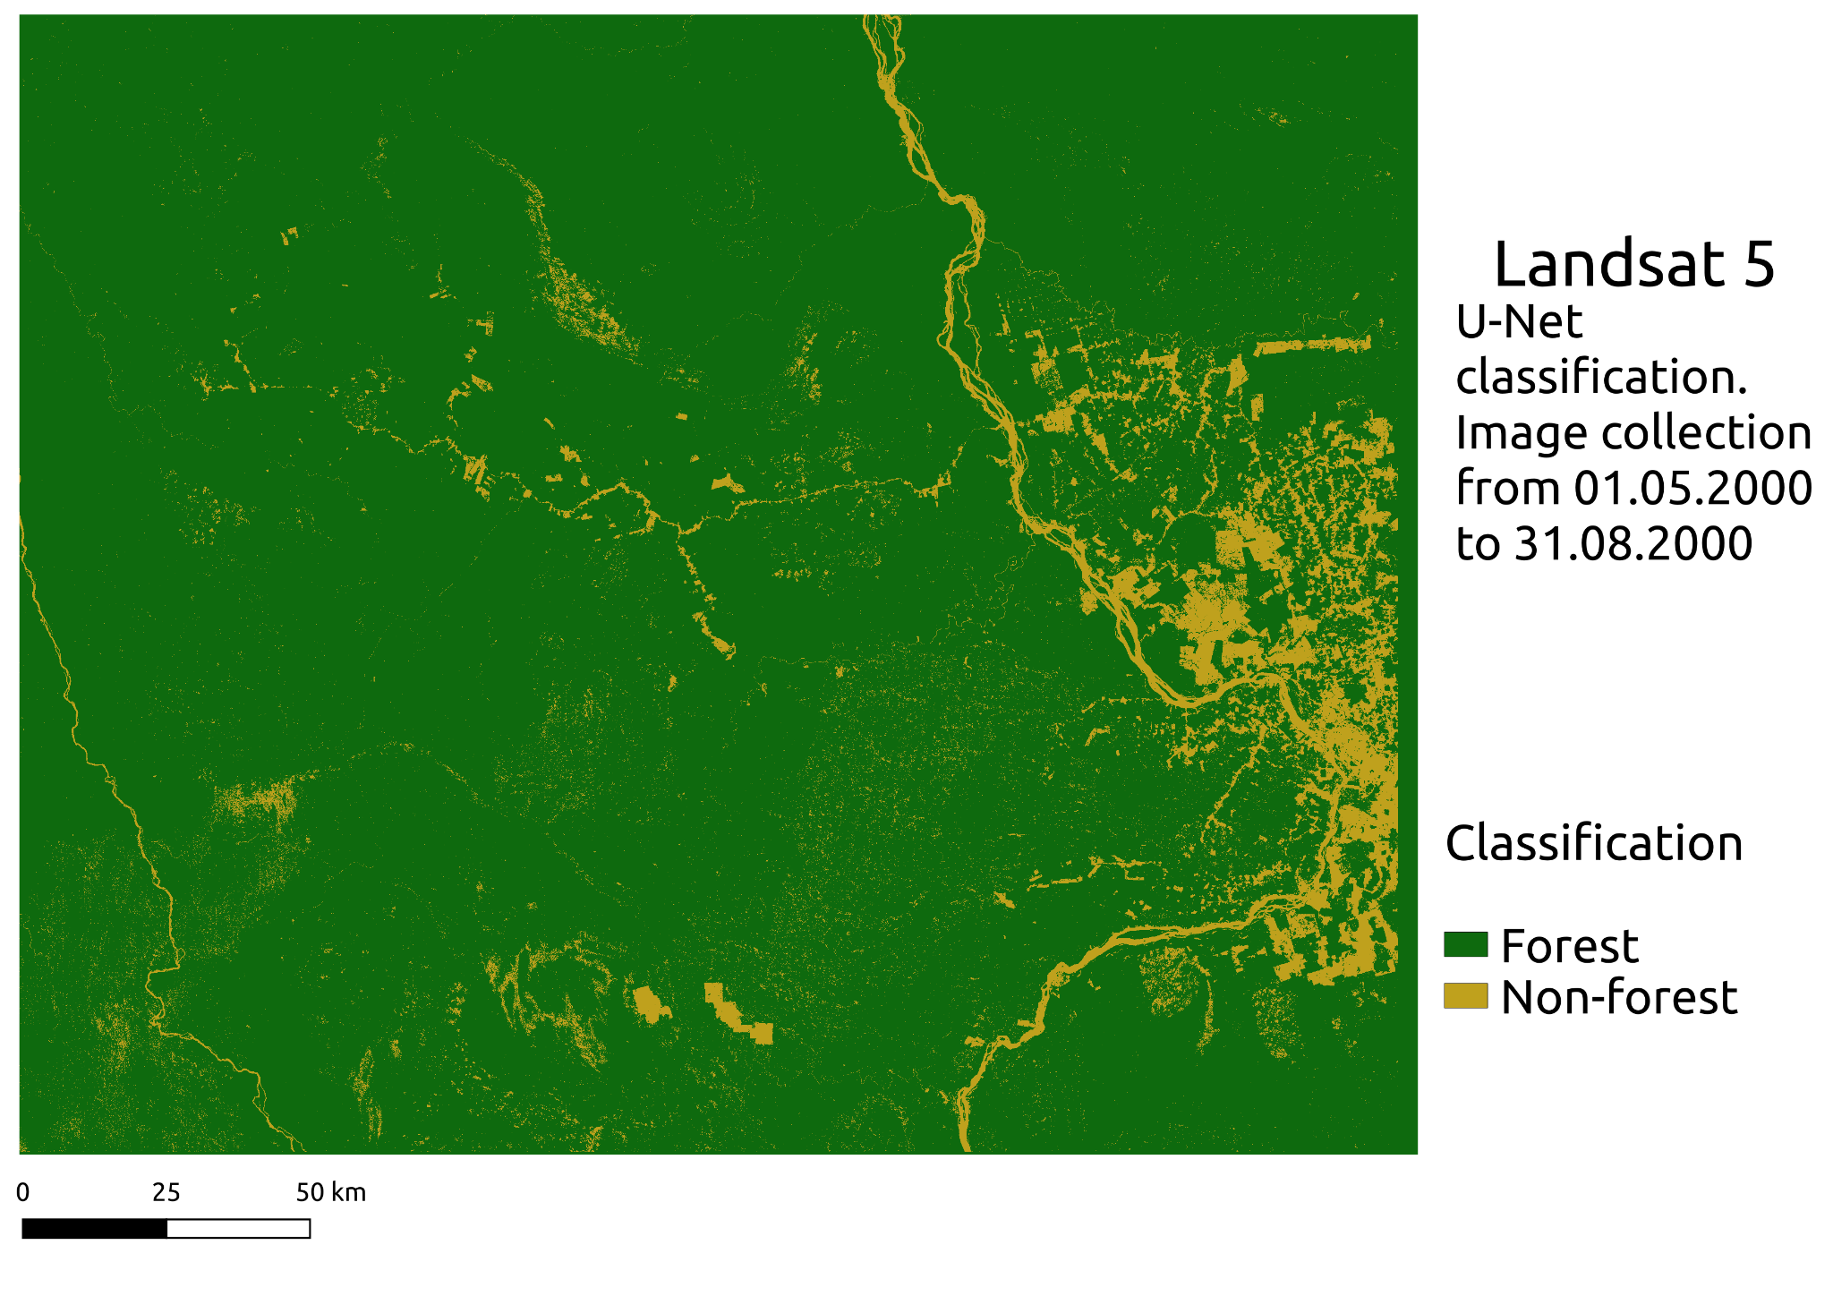
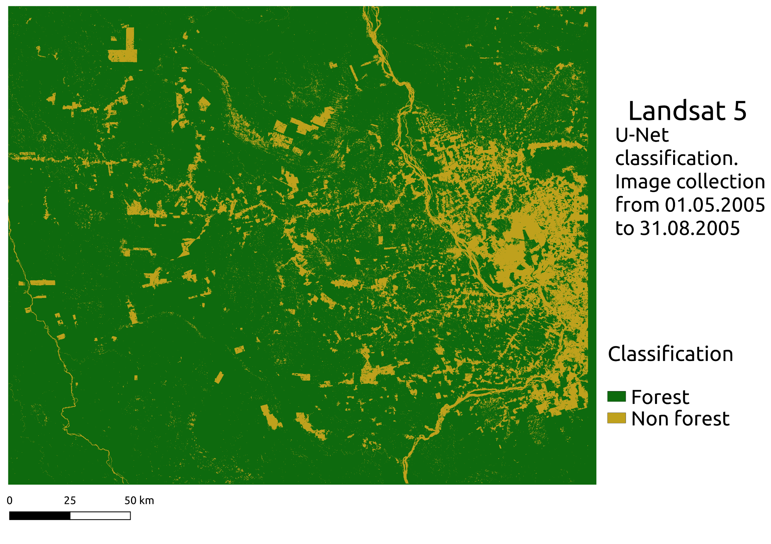
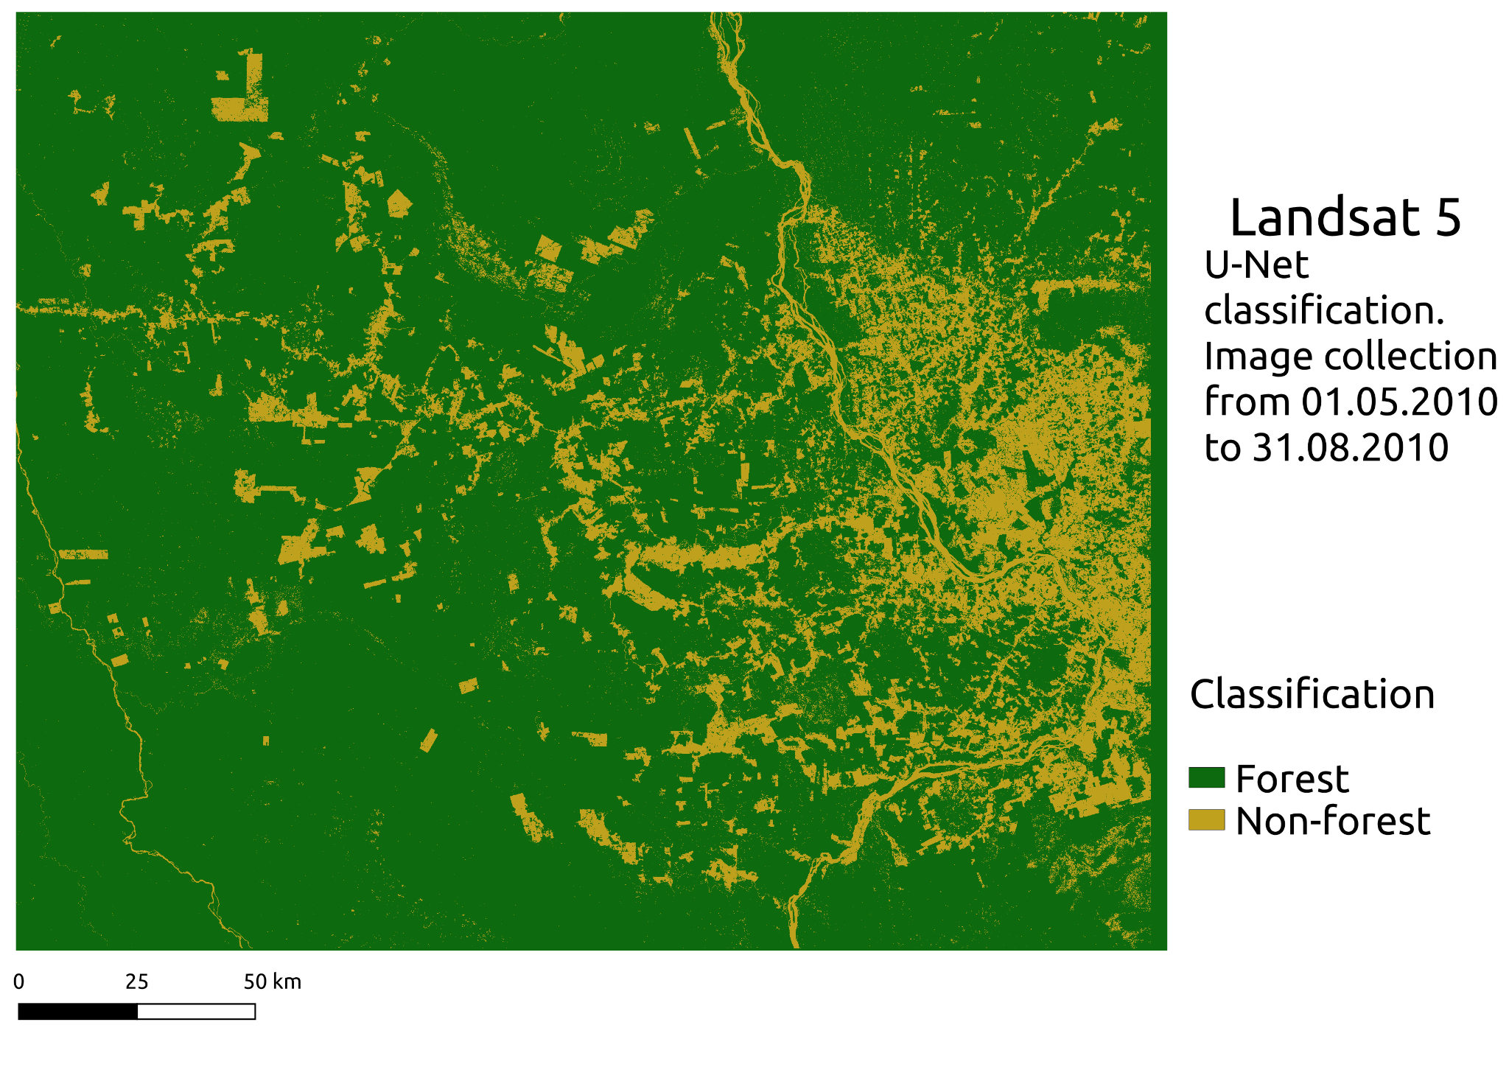
Results - classifications Landsat 5
2000 Landsat 5
2005 Landsat 5
2010 Landsat 5
Overall accuracy
0.93
Kappa 0.92
Forest
Non-forest

Slide 24
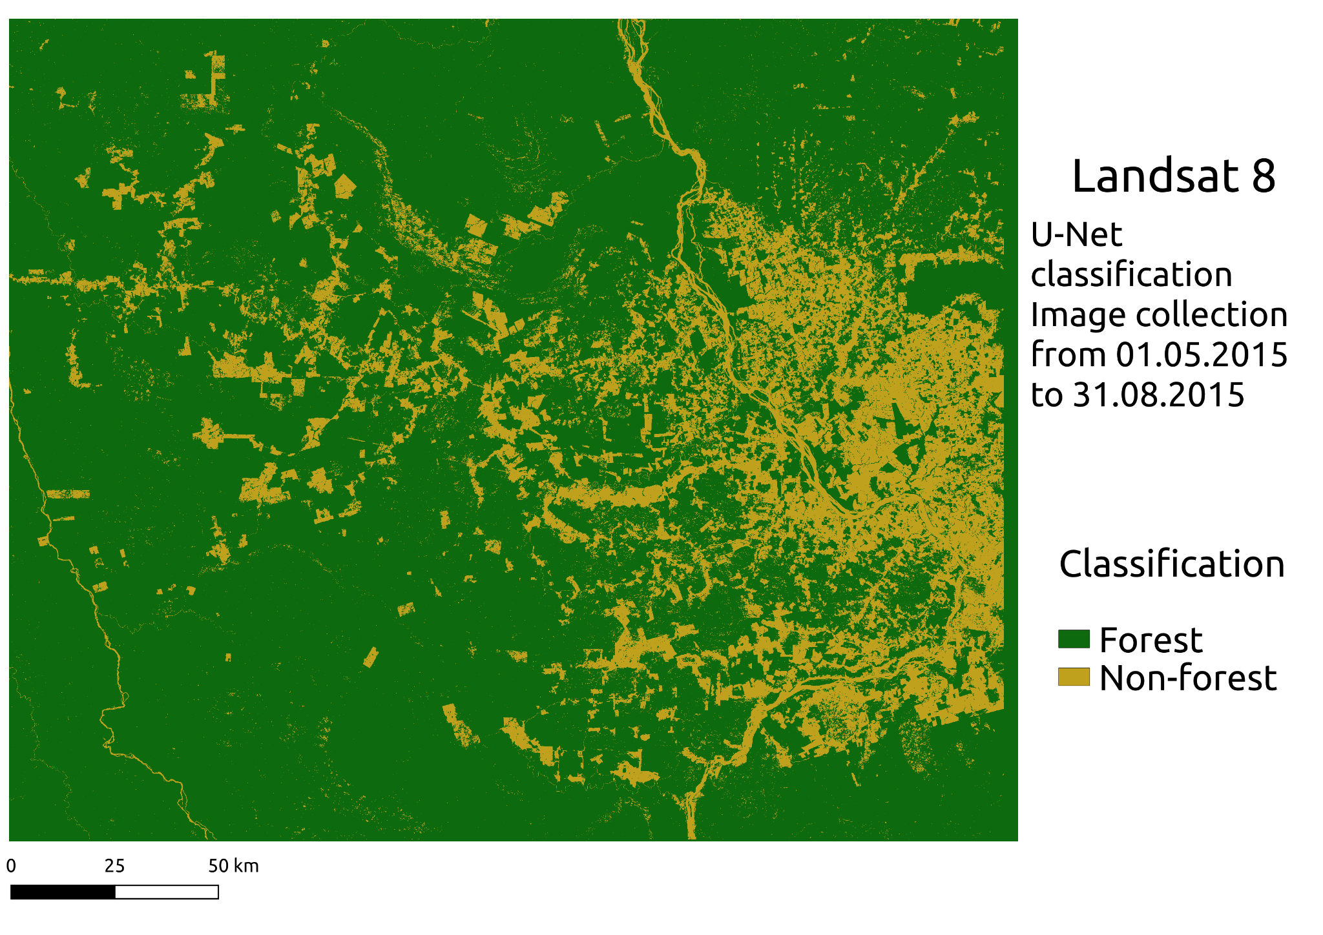
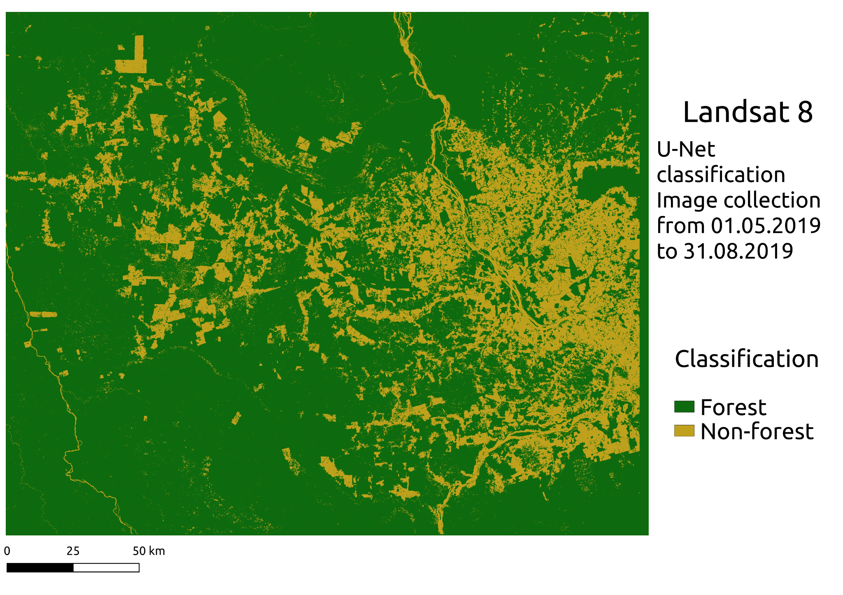
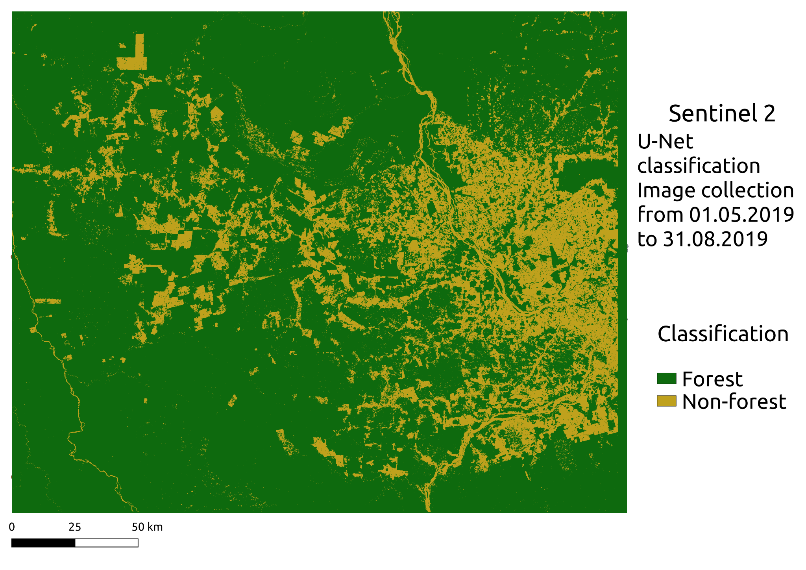
Results - classifications Landsat 8 and Sentinel 2
2015 Landsat 8
Overall accuracy
0.99
Kappa 0.98
2019 Landsat 8
Overall accuracy
0.96
Kappa 0.96
Sentinel 2 2019
Overall accuracy
0.96
Kappa 0.96
Forest
Non-forest

Slide 25
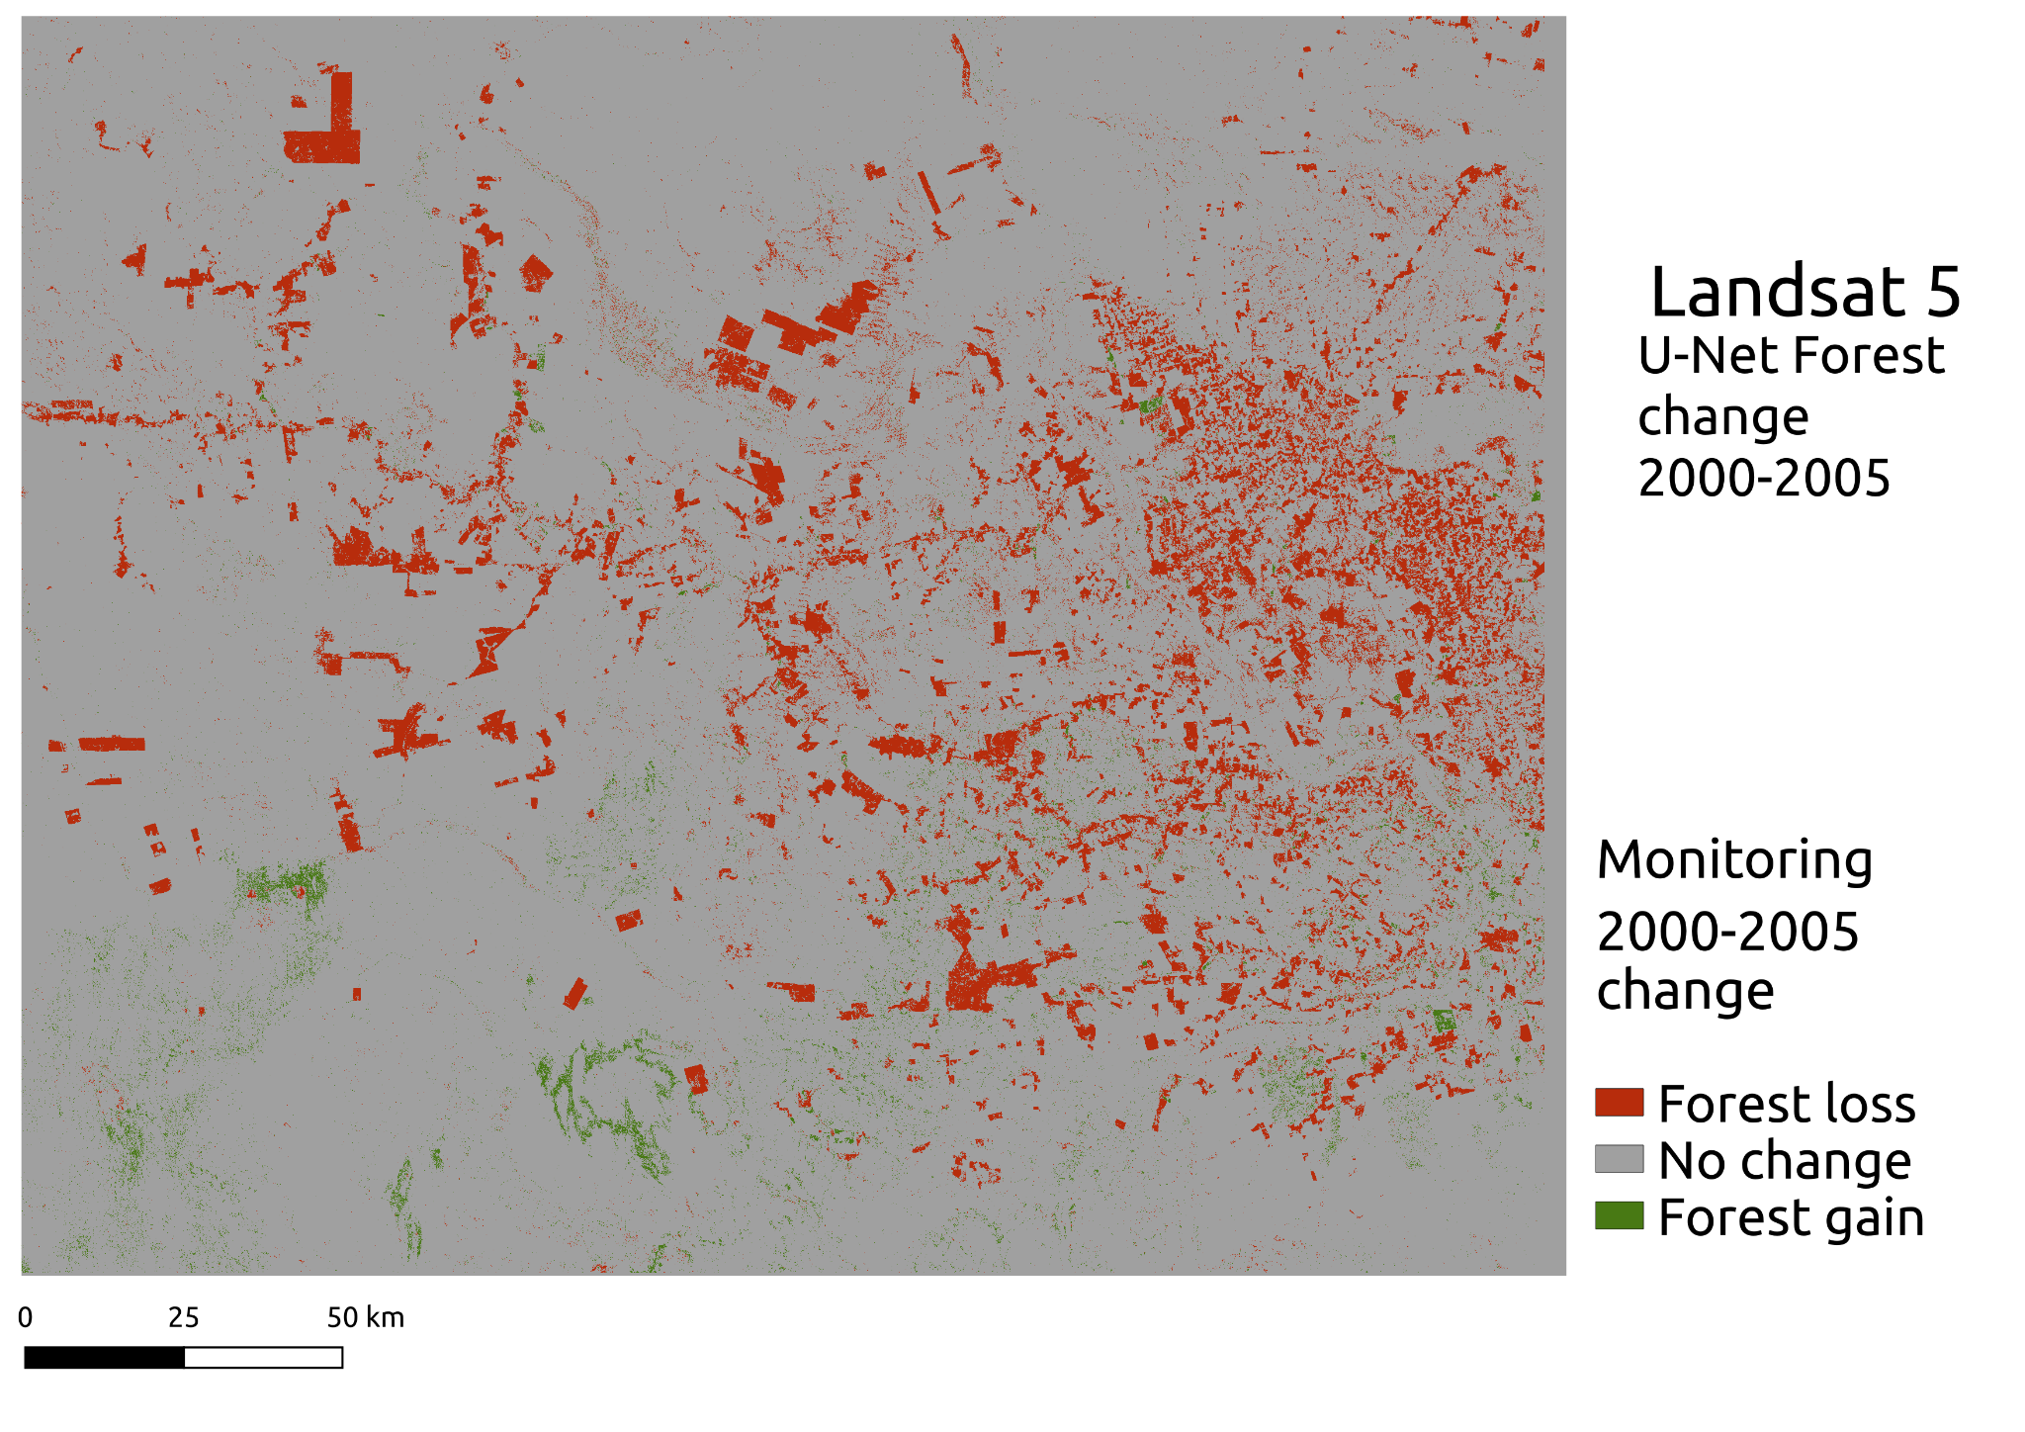
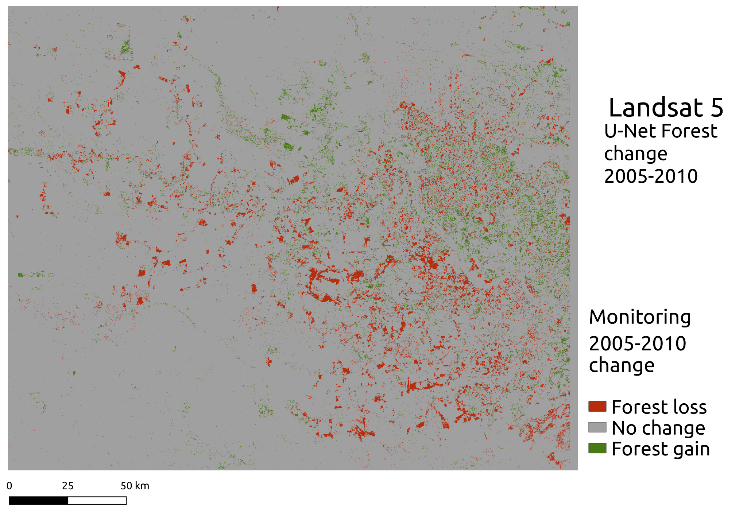
Results - forest change
2000-2005
Loss: 4052 km²
Gain: 623 km²
2005-2010
Loss: 2101 km²
Gain: 1407 km²
Forest gain
No change
Forest loss

Slide 26
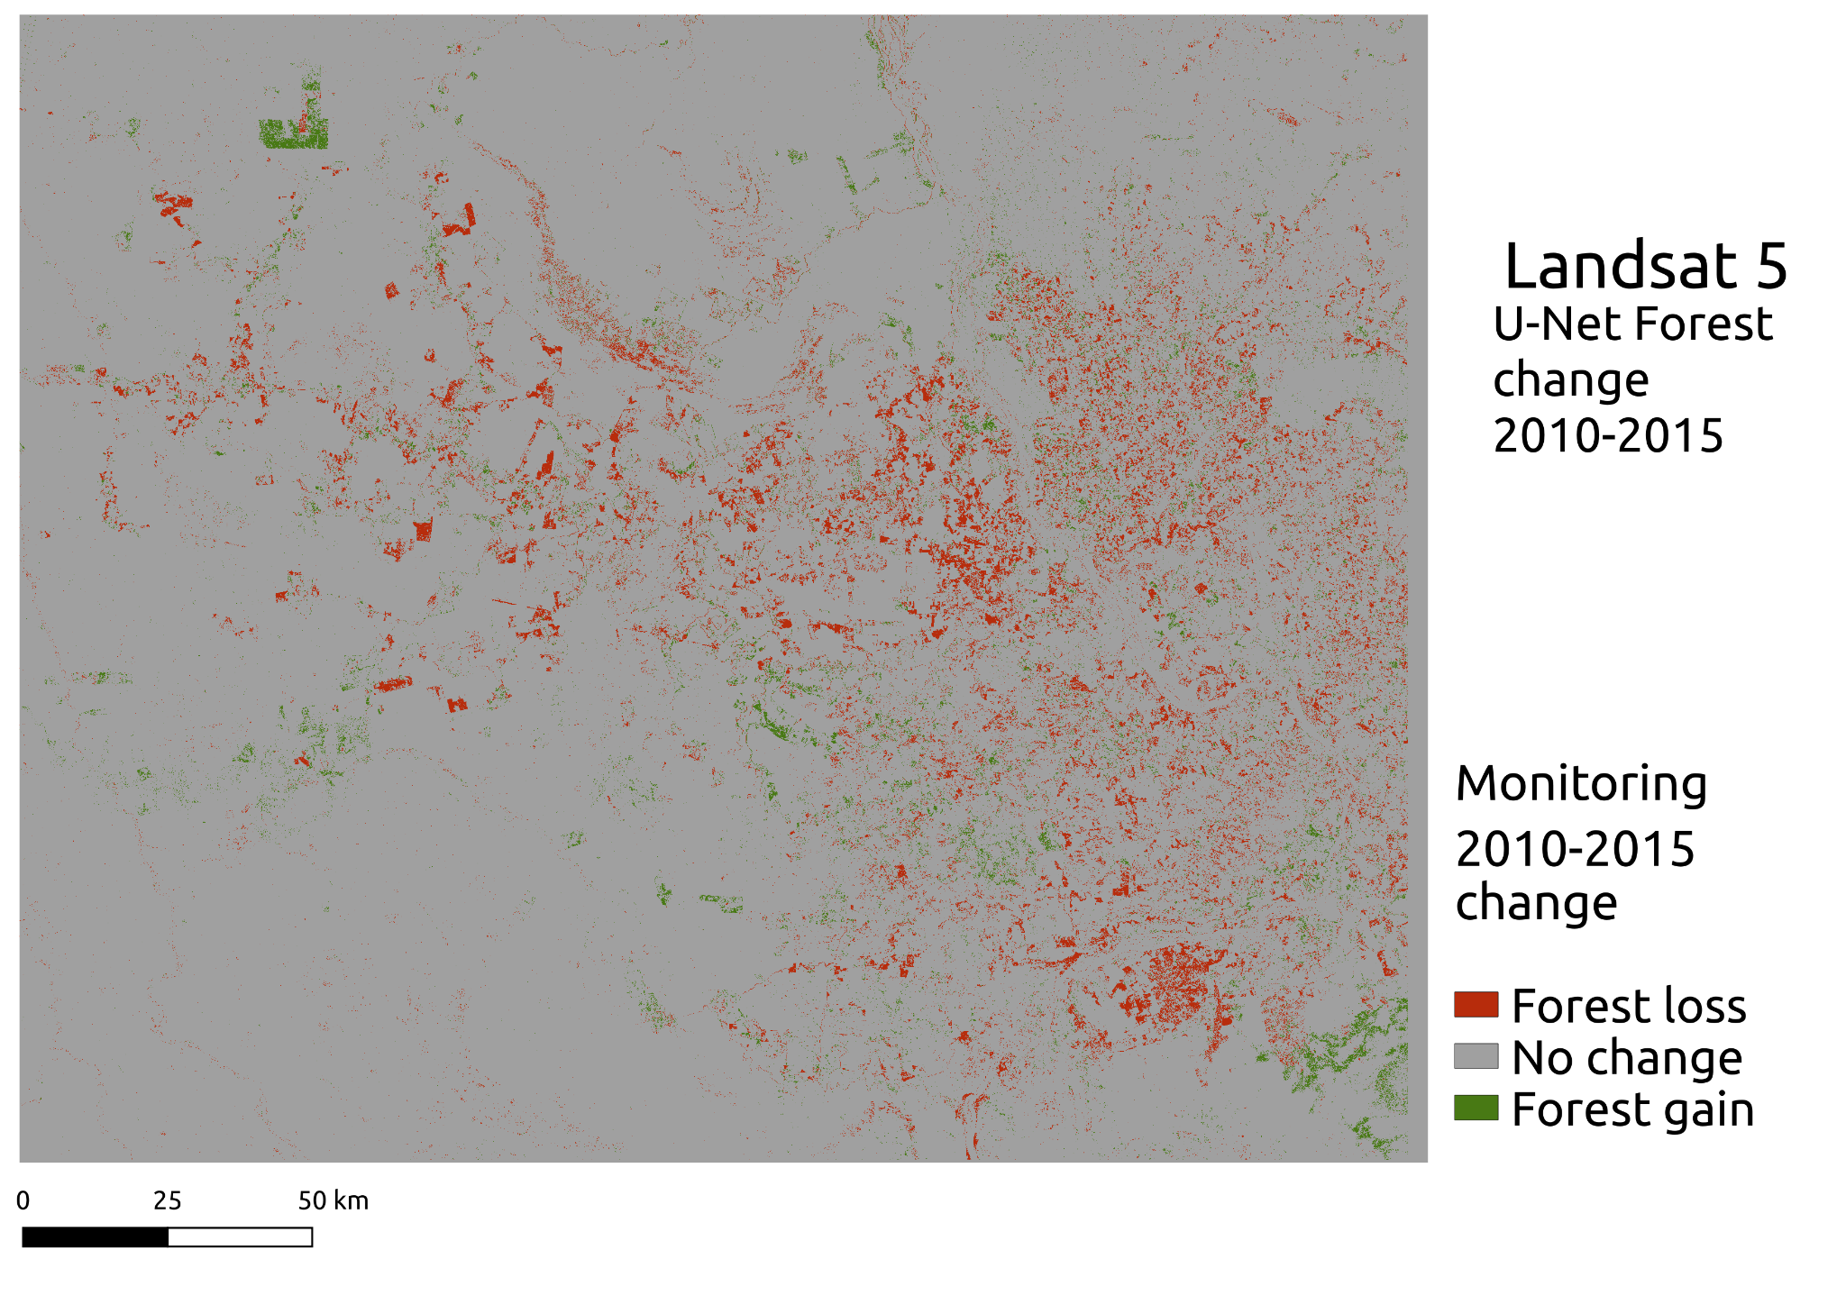
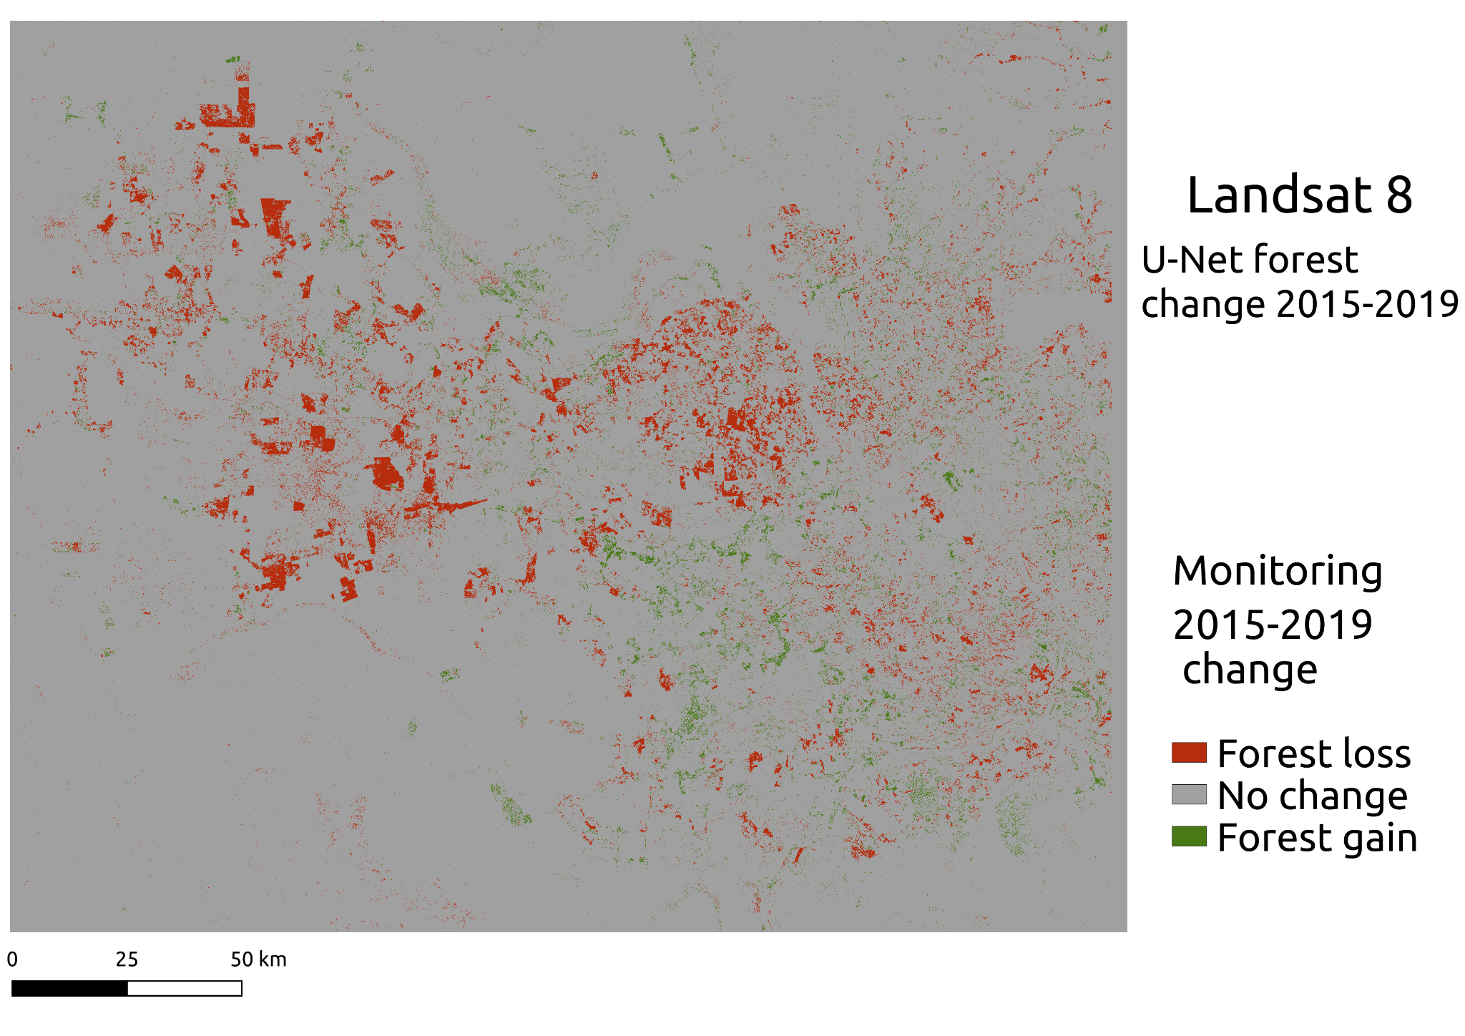
Results - forest change
2010-2015
Loss: 2139 km²
Gain: 825 km²
2015-2019
Loss: 2101 km²
Gain: 839 km²
Forest gain
No change
Forest loss

Slide 27
Conclusion
U-Net classification is a good option for ad-hoc classifications.
The tuning parameters of this experiment included the kernel size, and the training dataset size and the diversity of the patches.
The overall accuracies of the whole experiment were 0.98 and 0.96. depending on the configuration.
Possible future work can include the analysis of other FCNN architectures, optimizers, loss functions and,in general, any parameters and design choices considered.

